Slide 1
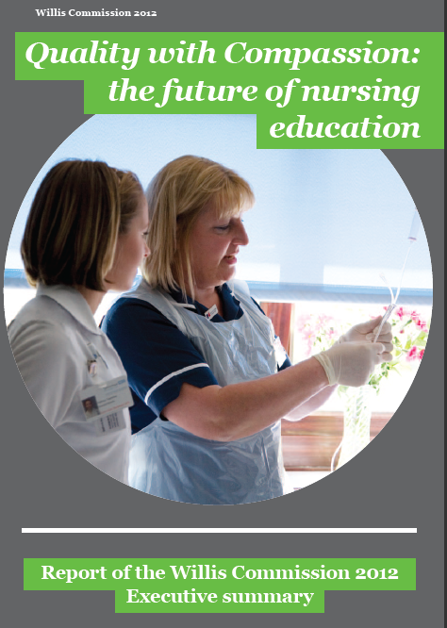

Slide 2
‘Nursing is a demanding yet rewarding profession that asks a lot of its workers. We are privileged to have such a dedicated and committed nursing workforce in the UK. Nursing is an incredibly self-aware profession, constantly striving to improve and give patients the best possible care. It is imperative that nurses are provided with the right education and skills to equip them for their roles’
Lord Willis of Knaresborough, commission chairman
Reports of poor nursing care sometimes imply that the quality of initial nursing education is at fault. In response to these claims, the Royal College of Nursing asked Lord Willis of Knaresborough to lead an independent inquiry into what excellent pre­registration nursing education in the UK should look like and how it should be delivered.
The Willis Commission on Nursing Education considered the following question:
What essential features of pre­registration nursing education in the UK, and what types of support for newly registered practitioners, are needed to create and maintain a workforce of competent, compassionate nurses fit to deliver future health and social care services?
The commission was launched in April 2012 and published its final report in November. Lord Willis chaired a panel of seven independent experts comprising service user representatives, nurse educationists, managers and practitioners from across the UK.
The commission set itself a clear mandate, engaged with many stakeholders, and reviewed and debated a large amount of evidence, including site visits to observe good practice. Its report, based on the most robust evidence available, represents the independent collective view of the chair and panel.

Slide 3
Patient-centred care should be the golden thread that runs through all pre-registration nursing education and continuing professional development.
The focus must be on helping service users, carers and families to manage their own conditions and maintain their health, and on involving them in recruitment, education programme design and delivery.
The commission found no major shortcomings in nursing education that could be held directly responsible for poor practice or the perceived decline in standards of care. Nor did it find any evidence that degree-level registration was damaging to patient care. On the contrary, graduate nurses have played and will continue to play a key role in driving up standards and preparing a nursing workforce fit for the future.
Nurses and their organizations must stand up to be counted, to restore professional pride and provide leadership and solutions to the challenges of poor care and a decline in public confidence.
Nursing education should foster professionalism which includes embedding patient safety as its top priority, and respects the dignity and values of service users and their carers.
Nursing education programmes must be better evaluated, and based on extensive research that provides evidence on the correlations between current practice, entry criteria and selection processes, attrition rates and course outcomes.

Slide 4
Our future healthcare system will require graduate nurses to practise and lead nursing and healthcare teams in a variety of roles, providing care in many settings.
High quality recruitment campaigns should be targeted at all potential nurses with a diversity of entry points and career pathways into nursing, including graduates of other professions, healthcare assistants and mature people as well as school-leavers, to encourage the best possible range of applicants.
All healthcare service providers must be full partners in nursing education, and recognise that the culture of the workplace is a crucial determinant of its success. Their boards must be able to demonstrate that they pay full attention to education issues.
Universities should fully value nursing as a practice and research discipline. Vice chancellors should work with nursing deans to develop a collective narrative about and commitment to the rightful place of nursing in universities.
Sustained attention should be paid to developing a strategic understanding of the nursing workforce as a whole and as a UK-wide resource. Workforce planning and the commissioning of education places must be evidence-based and conducted in effective local and national partnerships.

Slide 5
Theme 1: The future nursing Workforce
Evidence of the positive impact of registered nurses on patient outcomes must be utilised by healthcare providers in planning the nursing skill mix.
Employers must make use of the enhanced skills of the emerging graduate nursing workforce, as an opportunity to drive up standards and provide effective leadership and supervision of the clinical nursing workforce.
Graduate nurses, as leaders of clinical teams, should supervise and delegate work to ‘registered healthcare assistants’ with clearly defined roles.
The numbers and roles of healthcare support workers who deliver patient care must be properly planned and regulated, in the interests of patient safety and care quality.
All staff at Agenda for Change bands 3-4 (and their equivalents outside the NHS) who deliver patient care should be trained to NVQ level 3 as the minimum UK standard, delivered by healthcare providers and further education.
A planned programme of regulation should begin with the mandatory registration of all staff who deliver patient care at Agenda for Change bands 3-4 (and their equivalents outside the NHS) by an independent regulator.
Governments, education institutions and employers must fulfil longstanding policy commitments to develop educational and employment models that widen access to establish how education works well, where and for whom, and leads nursing education, and provide career pathways for healthcare support workers including those who wish to train as nurses or midwives.

Slide 6
Theme 2: Degree-level registration
The public needs to know what it can expect of registered nurses educated at degree level. Stakeholders should scale up recruitment campaigns and other measures, including dialogue with the media, to promote better understanding of contemporary nursing and nursing education and dispel the myth that better educated nurses are less caring.
Urgent action is needed to support the nursing academic workforce and guarantee its future quality: halt the decline in numbers, raise morale, and attract new staff.
A national clinical-academic career structure should be established, to ensure time and opportunity to teach in care delivery settings as well as the classroom, support engagement in research focused on improving care, and ensure education is patient-centred. Incentives should be introduced for establishing joint University­healthcare provider roles.
Greater investment is needed to strengthen the evidence base of pre-registration education. High quality research should be commissioned through collaborative partnerships between universities that also engage service users and healthcare providers in systematic and rigorous evaluation to the desired outcomes.

Slide 7
Theme 3: Learning to nurse
The quality of many practice learning experiences urgently needs improvement. Learning to care in real-life settings lies at the heart of patient-centred education and learning to be a nurse.
The NMC standards must be fully implemented through active partnerships between NHS education and training boards at national and local levels, employers and universities, to ensure the quality of nursing education, and use and share existing tools and standards.
Managers, mentors, practice education facilitators and academic staff must work together to help students relate theory to practice. Close, effective collaboration between universities and practice settings should be enhanced through joint appointments.
Employers and universities must together identify positive practice environments in a wide range of settings. Many more placements must be made available in community settings, including medical general practice. The absence of funding to HEIs to support nursing students’ practical learning experiences must be addressed.
Employers must ensure mentors have dedicated time for mentorship, while universities should play their full part in training and updating mentors. Mentors must be selected for their knowledge, skills and motivation; adequately prepared; well supported; and valued, with a recognised status.
Practical learning must be underpinned with relevant knowledge from clinical and social science disciplines. All students should be aware of the growing evidence base on good nursing practice. Graduate nurses, as future leaders of clinical teams, should understand how to evaluate, utilise and conduct research, and act on evidence to improve the quality of care.

Slide 8
Theme 4: Continuing professional development
A national nursing career framework must be implemented urgently by all partners and properly resourced. It should be based on the four governments’ existing policies of building career frameworks and pathways that support movement between and synthesis of practice, management, education and research, that value and reward different career paths, and will attract and retain high quality recruits.
Employers, universities, regulatory bodies and royal colleges should recognise, fund, promote and support nurses’ continuing professional development at appropriate and equitable levels as an investment for the future.
The NMC recommendation that newly qualified nurses undergo a post-qualification ‘preceptorship’ period of consolidation must be fully implemented to promote safe, high quality care.
Interprofessional learning must play a key role in continuing professional development. Training professionals in teams must also have a much stronger focus in pre­registration nursing education.

Slide 9
Theme 5: Patient and public involvement in nursing education
The NMC standards on patient and public involvement in pre­registration nursing education must be fully implemented, as a vital step in putting the experiences of patients and the public at the heart of nursing education.
Local education and training boards (and their equivalents), healthcare providers and universities should jointly deliver a comprehensive, strategic and transparent approach to patient and public involvement in pre-registration nursing education. It should encompass training and rewards for service users and carers, and development for academic and clinical staff so they can work with service users in a meaningful way.
Healthcare providers must actively promote and support patient and public involvement in nursing education through their patient experience strategies, education strategies and board-level quality assurance processes.

Slide 10
Theme 6: Infrastructure
The regulation and inspection of the many organizations and settings where nursing education is delivered should be streamlined and better integrated to increase effectiveness and reduce the heavy audit burden. Healthcare and education regulators should work in close partnership, and take full heed of each other’s findings. Their processes should be streamlined and duplication reduced.
The culture of healthcare provider organizations should be routinely assessed, building on ongoing work to develop and standardise a ‘cultural barometer’ that will help their boards ensure that practice settings are suitable learning environments.
Pre and post-registration nursing education must have equitable access to resources through introducing a level playing field and fair funding mechanisms to end the wide disparities between the overall funding of different health professions’ education. Sustainable funding is essential to ensure effective mentorship and support placements in community settings.
A long-term, sustainable funding model should be developed across the UK to support the education and training of future nurses, including adequate financial support for students and bursaries to support mature students.
The four UK governments should include pre-registration nursing programmes in future allocations of the service increment for teaching (SIFT) and its equivalents. This is vital to improve the quality of nursing students’ practical learning experiences, especially in community settings where many will work in future.

Slide 11
For more information and to see the evidence, visit the Willis Commission website at www.williscommission.org.uk

